Slide 1


LAMBDA FUNCTIONS AND DYNAMIC ARRAYS

Slide 2
Agenda
The Why
Cell Reference Hell
Lambda Libraries
GitHub
ChatGPT
The How
Functional Fundamentals
Comparing Dependency Patterns
Building your own functional illustration

Slide 3
The Why

Slide 4
Uses of Excel
Data Processing
Results Illustration
Logic Demonstration

Slide 5
Business Use Case
Third party does illustration for agents.
We throw a spreadsheet over the wall to display logic of new products.
Spreadsheet has grown in complexity over the years to accommodate all new product ideas.
People complain at lead time required to get third party to implement illustration.
Problem: Logic is convoluted and scattered throughout a large spreadsheet.
Regardless if third party or not, it will take them a long time to find changes and parse logic!
Solution: Find a way to make the logic transparent to the users downstream.
This should reduce the lead time required and improve accuracy of the implementation.

Slide 6
Eliminating Cell Reference Hell
Withdrawal Penalty - Classic
=IF($C9 <> 0,IF($F9, 1 - MAX(0, $C9 - $P8) / ($D8 - $P8), 1 - $C9 / $D9), 1)
Cell References scattered through logic, which is source of the problem.
Withdrawal Penalty - Map
=MAP( $D8 , $P8 , $C9 ,$D9, $F9 , $P9,
LAMBDA(prevCV, prevMAWA, WdTaken, Cv, isActivated, mawa,
LET(noWd, 1,
IF(WdTaken <> 0,
IF(isActivated,
1 - MAX(0, WdTaken - prevMAWA) / (prevCV - prevMAWA),
1 - WdTaken / Cv),
noWd))
)
)
Mapping a cell references to Lambda parameters.
All logic is separated from cell references, so moving the right direction.
Better, but still has problem of not understanding the logic between columns.

Slide 7

Wringing Out Logic into Lambda Libraries

Slide 8
Smart Lambda Libraries Make Dumb Spreadsheets!
Pay Period =SEQUENCE(Periods,,0,1/2)
Purchase Payments = 100000
Withdrawal Taken = 0
Assumed Contract Value = 100000
Is Anniversary =VA.IsAnniversary(A9#)
Is Activated =VA.IsActivated(A9#,ActivationPeriod)
INCOME BASE =DROP(
Utils.MulitSCAN({$C$9, $C$9, $C$9,0},
HSTACK($A9#,$C9#, $D$9#, $E9#, $F9#, $B9#,SEQUENCE(Periods,,MawRate,0)),
VA.MawStack)
,0,1)
Protected Income Payment =MAP($D$9#,CHOOSECOLS($G$9#,1),SEQUENCE(Periods,,pipRate,0),VA.ProtectedIncomePayment)
Being dumb is a good thing!

Slide 9
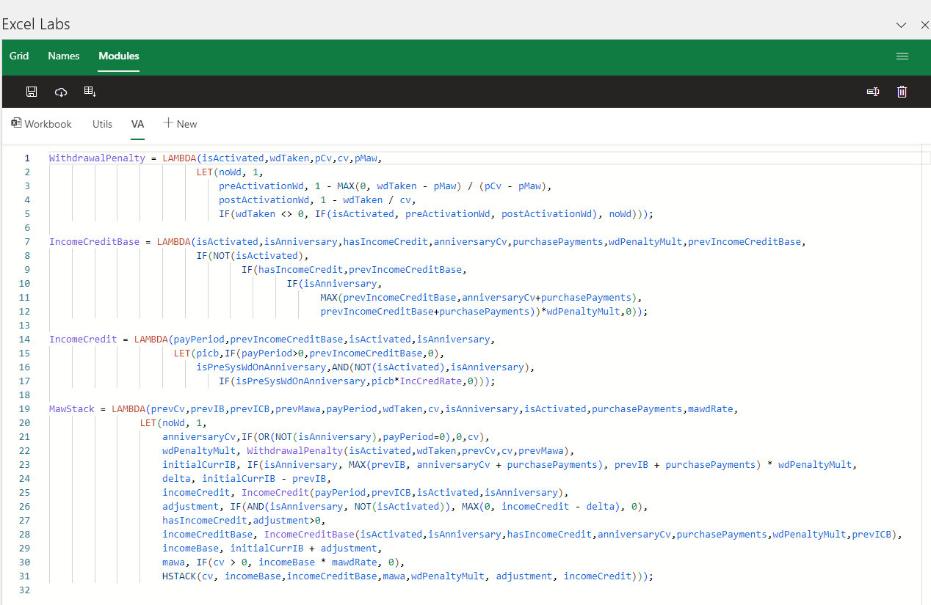
Advance Formula Environment (AFE)
Used for managing reusable libraries
Libraries can be saved into different names spaces
Updates can be easily saved
New formulas imported from spreadsheet into the library
New versions can be downloaded from GitHub.
https://www.microsoft.com/en-us/garage/profiles/excel-labs/

Slide 10

Version Control of Libraries GitHub
We can track changes to the library over time, so we understand changes.
Can easily collaborate with GitHub and fork libraries
https://gist.github.com/RubyTheActuary/cd905e4a97ae6ba88584449b930b57df

Slide 11
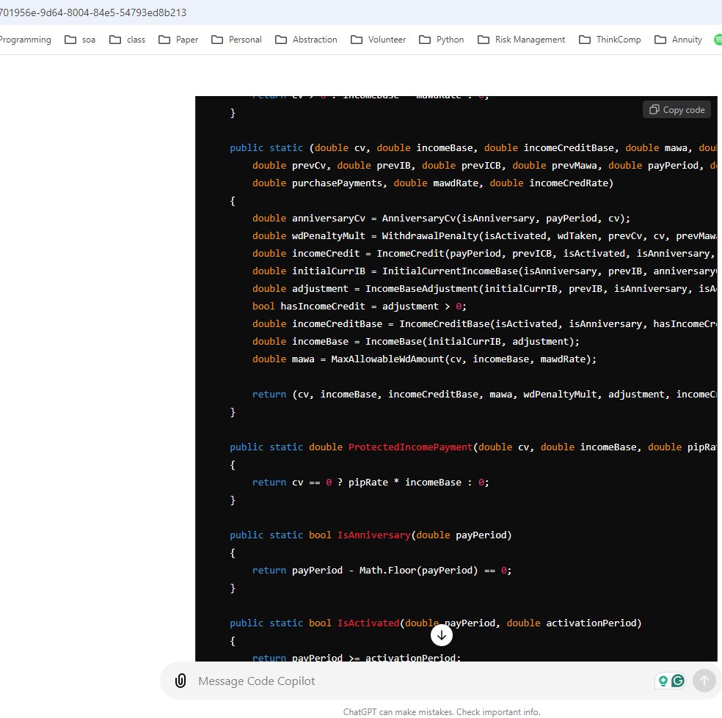
Converting Libraries for other Systems
Typed in to ChatGPT 4.0: Convert Excel Lambdas to C# Followed by Lambda Library Code.
https://chatgpt.com/

Slide 12
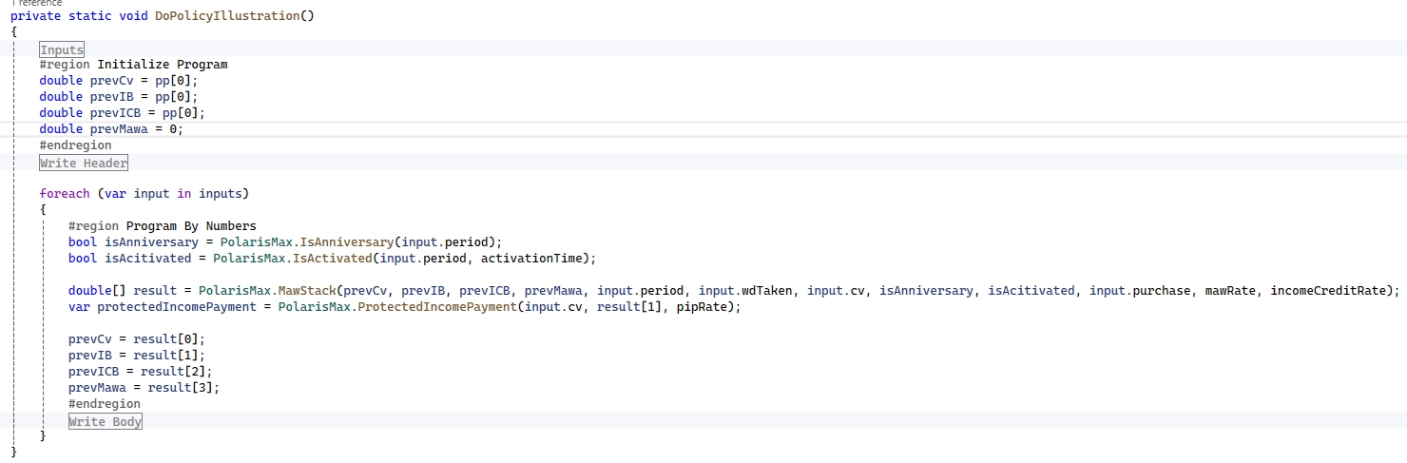
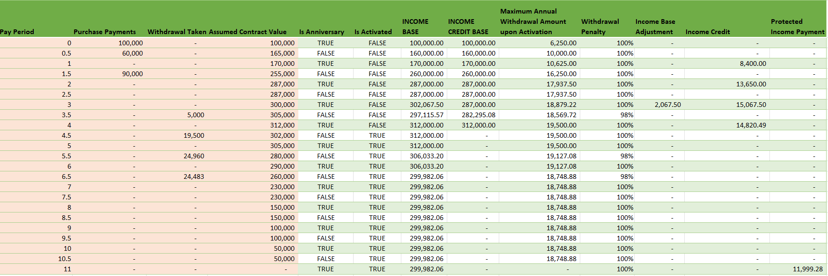
Bang Out Prototype to Match Excel

Slide 13
Why Dynamic Arrays and Lambda Functions?
We separate logic from cell references, which makes logic easier to understand.
We can create a reusable library of components, so other projects move faster.
Free version control of changes.
These libraries can be easily converted to other languages, which will increase turnaround time of new products.
Functions can be tested independent and debugged independent of the actual calculation.

Slide 14
The How

Slide 15

Functional Programming Fundamentals

Slide 16
Functional Programming Concepts
The central concepts are:
Pure functions: Functions that return the same output for the same input and have no side effects.
Immutability: Corresponds to unchangeable data structures after their creation.
Higher-order functions: Functions that take other functions as arguments or return functions.
Function composition: Combining functions to create more complex functions.
Recursion: Due to immutability, there is no concept of a for or while loop like in procedural languages. To iterate over a structure requires recursion, which is a function that calls itself.
Modeled after pure functional languages like Haskell.

Slide 17

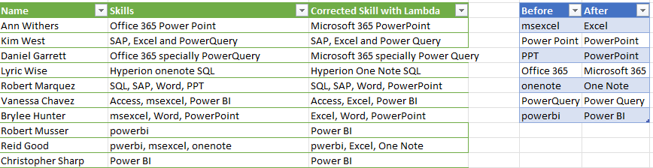
Mega Replace Recursion
Popular personality on building Excel functionality.
She built a recursive equation to fix text strings.
Her explanation is great, but it can be improved.
Mega Replace - https://www.youtube.com/watch?v=L7s6Dni1dG8

Slide 18
Recursion and Impurity
The Video’s Formula
MegaReplace =
LAMBDA(text,beforeText,afterText,
LET(result,SUBSTITUTE(text,beforeText,afterText),
IF(beforeText="",result,MegaReplace(result,
OFFSET(beforeText,1,0),
OFFSET(afterText,1,0)))));
Before | After | ANSWER
msexcel | Excel | Office 365 Power Point
Power Point | PowerPoint | Office 365 PowerPoint
PPT | PowerPoint | Office 365 PowerPoint
Office 365 | Microsoft 365 | Microsoft 365 PowerPoint
onenote | One Note | Microsoft 365 PowerPoint
PowerQuery | Power Query | Microsoft 365 PowerPoint
powerbi | Power BI | Microsoft 365 PowerPoint

Slide 19
Important Lambda Helper Functions
MAP : uses 1 to many arrays to transform to a single result
REDUCE: Compress a list to a single value. Classic Example: SUM or PRODUCT
SCAN: Is a running total.
HSTACK : Stacks column vectors
VSTACK : Stacks row vectors
DROP : Drops the first item from a vector
TAKE: Takes the first item from a vector
ISOMITTED: True if parameter omitted from lambda.
https://www.thespreadsheetguru.com/dynamic-array-function-list/

Slide 20
Recursion and Purity
Correcting Video’s Formula
MegaReplaceFix =
LAMBDA(text,beforeArray,afterArray,
LET(b,TAKE(beforeArray,1),a,TAKE(afterArray,1),v,SUBSTITUTE(text,b,a),
IF(COUNTA(beforeArray)-1=0,
v,
MegaReplaceFix(v,DROP(beforeArray,1),DROP(afterArray,1)))
)
Before | After | ANSWER
msexcel | Excel | Office 365 Power Point
Power Point | PowerPoint | Office 365 PowerPoint
PPT | PowerPoint | Office 365 PowerPoint
Office 365 | Microsoft 365 | Microsoft 365 PowerPoint
onenote | One Note | Microsoft 365 PowerPoint
PowerQuery | Power Query | Microsoft 365 PowerPoint
powerbi | Power BI | Microsoft 365 PowerPoint

Slide 21
Reduction and Higher-Order Functions
Best Correction for Video Formula
MegaReplace2 = LAMBDA(text,beforeArray,afterArray,
REDUCE(text,
MAP(beforeArray,afterArray,
LAMBDA(before,after,
LAMBDA(t,SUBSTITUTE(t,before,after))))
,LAMBDA(text1,func,func(text1))));
INPUT | REDUCE Explanation | ANSWER
Office 365 Power Point | LAMBDA(Office 365 Power Point,SUBSTITUTE(Office 365 Power Point,msexcel,Excel) | Office 365 Power Point
Office 365 Power Point | LAMBDA(Office 365 Power Point,SUBSTITUTE(Office 365 Power Point,Power Point,PowerPoint) | Office 365 PowerPoint
Office 365 PowerPoint | LAMBDA(Office 365 PowerPoint,SUBSTITUTE(Office 365 PowerPoint,PPT,PowerPoint) | Office 365 PowerPoint
Office 365 PowerPoint | LAMBDA(Office 365 PowerPoint,SUBSTITUTE(Office 365 PowerPoint,Office 365,Microsoft 365) | Microsoft 365 PowerPoint
Microsoft 365 PowerPoint | LAMBDA(Microsoft 365 PowerPoint,SUBSTITUTE(Microsoft 365 PowerPoint,onenote,One Note) | Microsoft 365 PowerPoint
Microsoft 365 PowerPoint | LAMBDA(Microsoft 365 PowerPoint,SUBSTITUTE(Microsoft 365 PowerPoint,PowerQuery,Power Query) | Microsoft 365 PowerPoint
Microsoft 365 PowerPoint | LAMBDA(Microsoft 365 PowerPoint,SUBSTITUTE(Microsoft 365 PowerPoint,powerbi,Power BI) | Microsoft 365 PowerPoint
Before | After | Map Before and After to Functions
msexcel | Excel | LAMBDA(t,SUBSTITUTE(t,msexcel,Excel)))
Power Point | PowerPoint | LAMBDA(t,SUBSTITUTE(t,Power Point,PowerPoint)))
PPT | PowerPoint | LAMBDA(t,SUBSTITUTE(t,PPT,PowerPoint)))
Office 365 | Microsoft 365 | LAMBDA(t,SUBSTITUTE(t,Office 365,Microsoft 365)))
onenote | One Note | LAMBDA(t,SUBSTITUTE(t,onenote,One Note)))
PowerQuery | Power Query | LAMBDA(t,SUBSTITUTE(t,PowerQuery,Power Query)))
powerbi | Power BI | LAMBDA(t,SUBSTITUTE(t,powerbi,Power BI)))

Slide 22
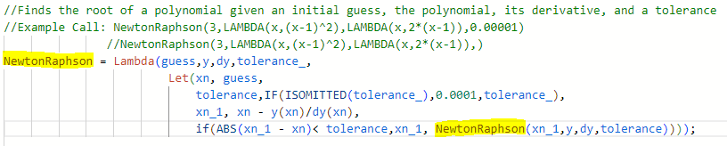
Lambdas and Recursion – Simple Example
Demonstrates:
Pure functions
Recursion
Higher-order functions
Function composition

Slide 23
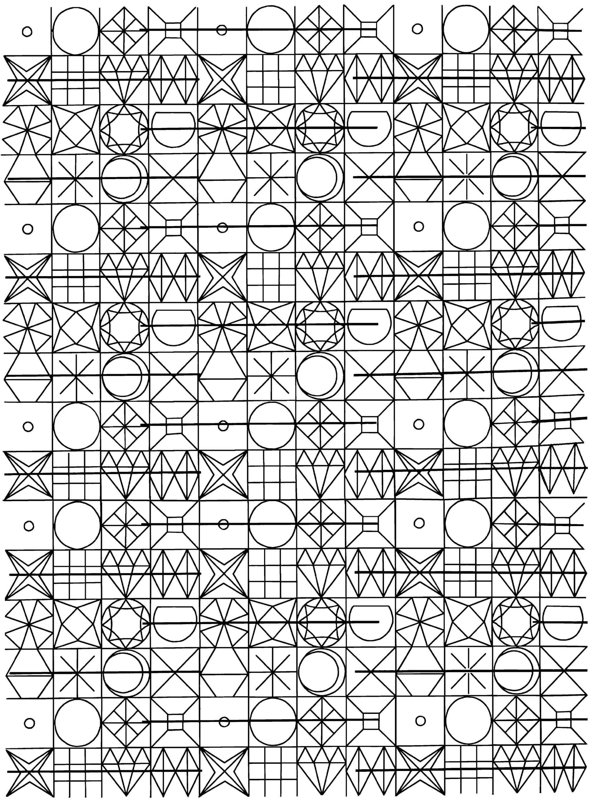
Comparing Dependency Patterns

Slide 24
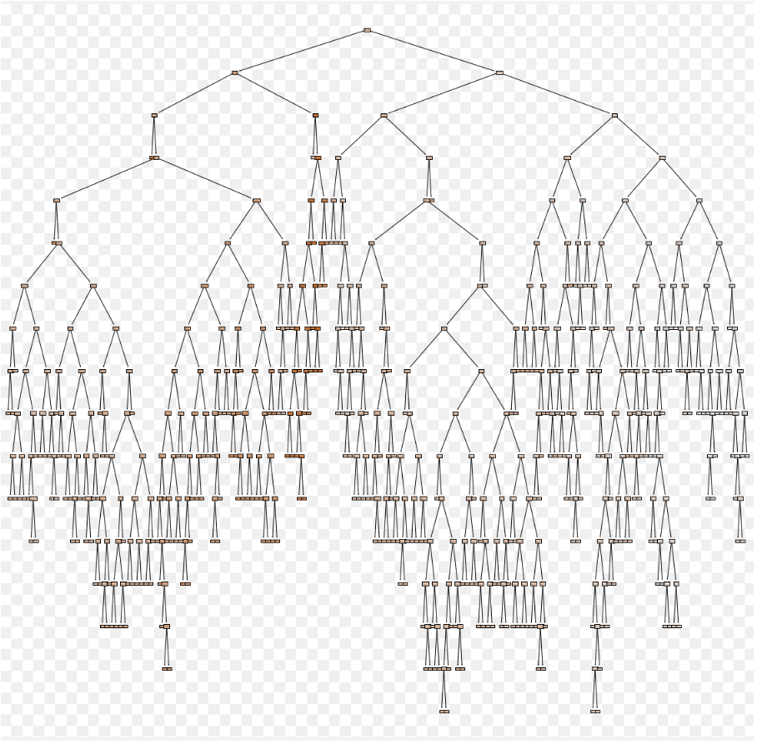
Classic Excel – Calculation Tree
When formulas are made Excel will determine the order of operation.
If the tree has any leaf that points to itself, then a circular reference occurs.
Lastly roll all results to the root node.
Ohio National Life Assurance Corporation
A member of the Constellation Insurance Inc. family of companies

Slide 25
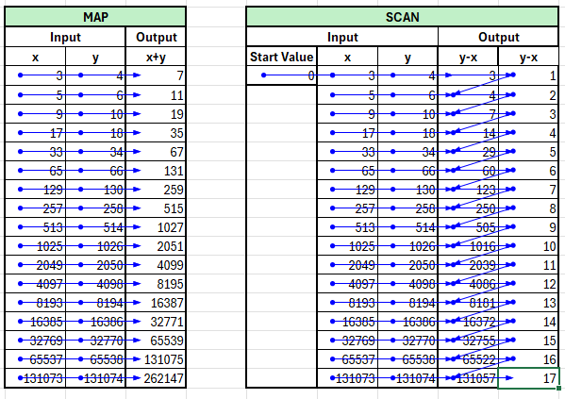
Classic Excel Pattern Dependencies
A map is a higher-order function that applies a given function to each element of a collection returning the results in a collection of the same type.
A scan is a higher-order function that takes a starting value and applies a function which is used to accumulate successive values. The intermediate values of this accumulation are returned as a collection of the same type.
SCAN documentation: https://support.microsoft.com/en-us/office/scan-function-d58dfd11-9969-4439-b2dc-e7062724de29
MAP =B5+C5
SCAN =G5-F5; =H5-G5; =G6-J5; =H6-I6

Slide 26
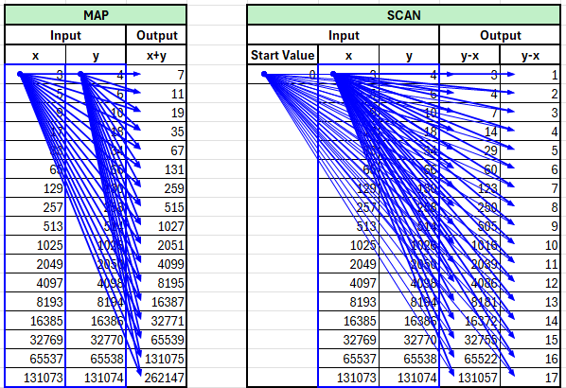
Dynamic Array Excel Pattern Dependencies
Dynamic Arrays in Excel 365 let you work with a range of values in a single cell.
Instead of entering a formula that outputs to a single cell, you can use a formula that "spills" results into neighboring cells automatically.
There are significant concepts to consider:
Spilling: The formula automatically fills cells with multiple values.
Dynamic: The output adjusts if the source data or formula changes.
Functions: Lambda functions can be applied consistently over the entire array.
Dynamic Arrays can be seen as super cells.
Notice how the dependency always refers to the starting cells of the input and spills into the output dynamic array.
=MAP($C$5:$C$21,D5:D21,LAMBDA(x,y,x+y))
=SCAN($G$5,$H$5#,LAMBDA(acc,curr,curr-acc))
Dynamic Array Function Documentation: https://www.thespreadsheetguru.com/dynamic-array-function-list/

Slide 27
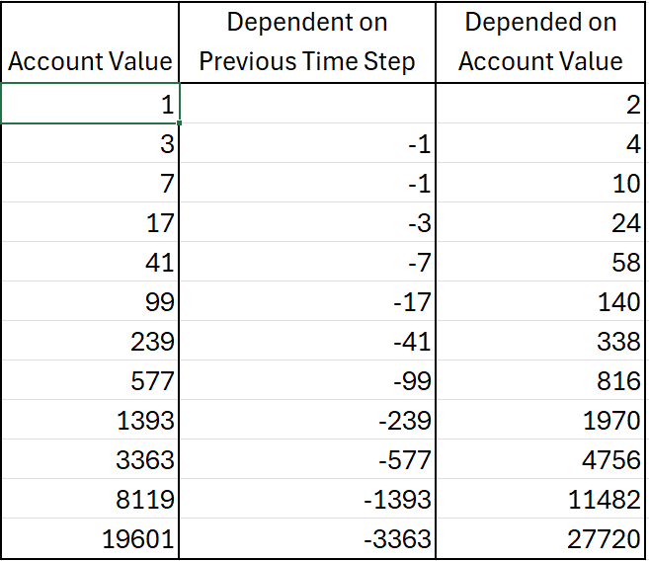
Understanding Complicated Dependencies in Classic Excel Illustrations
Notice the Functional Triangle that causes the circular reference when only using dynamic arrays and lambda helper functions.
This is a very common pattern with annuities due to the interaction between benefit bases and account values.
This pattern will force you to create a lambda library by consolidating logic between columns.

Slide 28
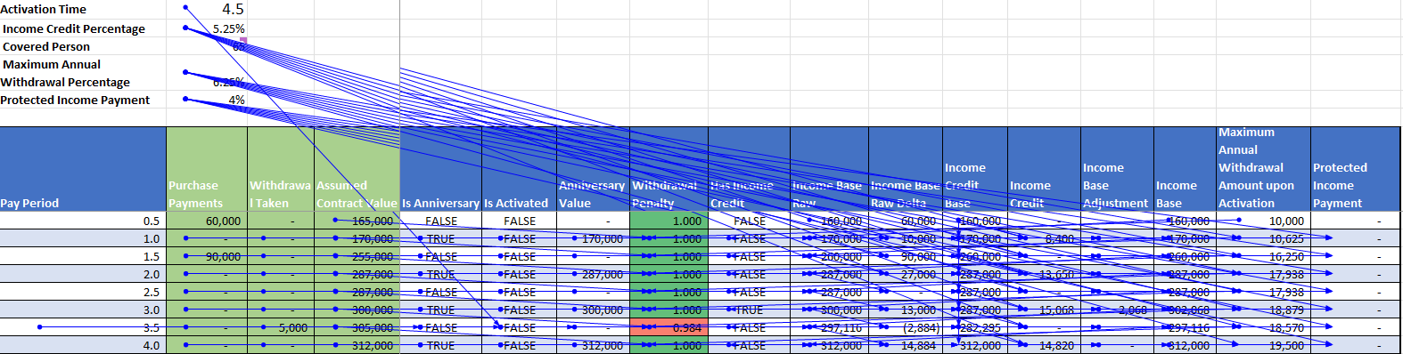
A Complicated VA Prospectus Classical Dependencies
Very complicated inner relationship among the dependencies even in this simplified example.
Even though complicated, there are no circular references in this classic Excel implementation.
Follows the SCAN and Death V dependency patterns.

Slide 29
Programming By Numbers

Slide 30
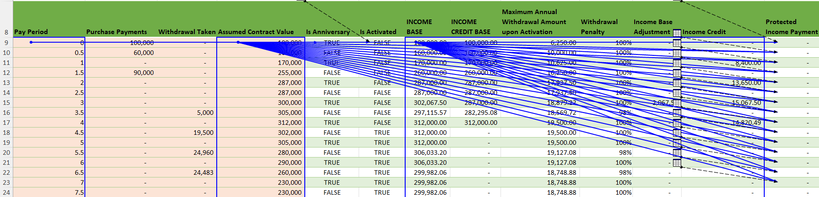
A Complicated VA Prospectus Dynamic Arrays Dependencies
See how the Illustration with dynamic arrays follow the pattern after logic has been extracted into the library.
Bad News: Requires a little more programming chops.

Slide 31

Issue with Divergence from Functional Programming.

Slide 32
SCAN Function Details and Limitations
SCAN function
Scans an array by applying a LAMBDA to each value and returns an array that has each intermediate value.
Syntax
=SCAN ([initial_value], array, lambda(accumulator, value, body))
Example =SCAN(1, A1:C2, LAMBDA(a,b,a*b))
The SCAN function syntax has the following arguments and parameters:
[initial_value] Sets the starting value for the accumulator.
array An array to be scanned.
lambda A LAMBDA that is called to reduce the array. The LAMBDA takes three parameters:
accumulator The value totaled up and returned as the final result.
value The current value from the array.
body The calculation applied to each element in the array.
Problems with Scan, Reduce, Map:
In Illustration, I want treat multiple items as a single object, but Excel treats each cell independently.
The initial_value expects an individual value instead of a list of values.
Problem this forces me to roll my own, which increase the need for programming chops.

Slide 33
More Functional Fun
List
Collection of items of the same type
Tuple
Collection of items of different types.
Tuples are used to create an object with different properties.
For example: Policyholder properties are issue age, gender, premium amount.
The tuple named policyholder would contain and integer, string, double.
The policyholder extract would be a list of policyholder tuples.
Problem: Excel combines these concepts.
It may sound a good simplification, but it complicates greatly!

Slide 34
Conclusion
The bad
It will require actuaries to increase their programming chops, but extremely doable.
Purely functional programming is a very different mindset than the imperative mindset of VBA.
The good
By relying only on lambda functions and dynamic arrays, we can greatly speed up the ability to communicate complicated logic to other interested parties.
We can easily read, translate, and version control business logic of the Excel code.
Reads far more mathematical and easier to relate to actuarial textbooks.
Given we are more accustomed to functional programming, I think it will give us 10X speed up for creating illustrations due to reusability of lambda libraries.
The tradeoff is worth it because it will increase the problem-solving capabilities of everyone involved.
Learning different programming paradigms is always worth the effort.
The new paradigm forces you into better programming habits
https://github.com/RubyTheActuary/Excel-Lambda-Examples

